Slide 1
Welcome! Before class starts, please:
Please see slides: https://goo.gl/yS153U for links
Download (and we’ll install together):
Git
SourceTree (GUI for Git)
Python 3.5+
PyCharm Community Edition

Slide 2
Stats 404:
Computational Statistics
Irina Kukuyeva, Ph.D.
Class 0: January 9, 2019

Slide 3
Ice Breaker
What’s your preferred name?
What’s your educational background or industry you are/want to work in?
Why did you sign-up for the course?
What’s one topic you’re (ideally) interested in learning in class?

Slide 4











Ice Breaker: My Background
Consulting
IoT
Healthcare
Media & Entertainment
Finance
CPG
Retail
Video Game Publisher
Social Media Agency
Ph.D.
Online Advertising
Fashion
Healthcare

Slide 5
Overview of Statistical Computing
Statistical Computing
Packages and languages for data analysis
Numerical methods in statistics
Computational Statistics
Computationally intensive statistical methods
Analysis of big data
Developing predictive models for production
Anything else?

Slide 6
Course Goals
As a result of this course, you’ll will learn best practices for statistical/machine learning software development in Python, for alignment with a career in industry.

Slide 7
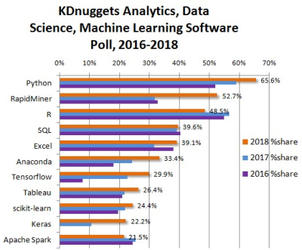
Course Goals -- Why Python?
Python has been growing in popularity
Embraced by beginners and professionals
Easier to collaborate with engineers
Easier to deploy work into production
Marketable skill in industry
Personally using Python/pySpark exclusively for past 5 years
[4]

Slide 8
Course Outline
Week 1 (today): Setting-up machine learning environment
Weeks 2-3: Introduction to Python
Weeks 4-5: Regression methods + numerical optimization + loss functions
Week 6: Python and Big Data
Week 7-8: Introduction to Software Development
Weeks 9 & 10: Final Project Presentations
NOTE: Attendance is mandatory for project presentations
NOTE: Presentation order = volunteer + random draw

Slide 9
Course Overview -- Admin
Website for course and GitHub repository
Syllabus (includes HW assignments, deadlines, class policies)
Laptop required to every class (can borrow one from CLICC lab)
Textbooks: not required
Contact me: irina.kukuyeva@stat.ucla.edu + [Stats 404] in email subject
OH: Tuesdays 7-8PM, https://zoom.us/j/622634325
Contact TA: Hao Wang hwang16@ucla.edu
Discussion section: Wednesdays 5-5:50PM (before lecture)
OH: TBD
OH location: MS 8145

Slide 10
Course Overview -- Admin
Do attend the last 2 days of the quarter for the oral presentations. Otherwise, attendance is not mandatory
Do let me know as soon as possible, if you are unable to make these dates, cannot fulfill the course requirements, or require special arrangements
Do not submit late assignments or ask for extensions
All homework assignments are posted and outlined in Syllabus
Note: lowest HW score will be dropped

Slide 11
Course Overview -- Admin
Do work independently for all homework assignments and on the project and presentation
Grading:
Homework and labs: 60% (lowest grade dropped)
Final project:
Presentation + attendance: 15%
Write-up: 15%
Code: 10%
NOTE: All homework assignments are posted and outlined in Syllabus

Slide 12
Final Project
Goal: Use Python and tools learned in this class to answer a business question based on a data set of your choice
Deliverable should showcase:
Business knowledge
Communication
Statistics/machine learning knowledge
Coding skills
TIP: Do solicit scientific review(s) and/or code review(s) from colleagues

Slide 13
Homework Assignments
HW 1: (slide 59) includes picking business topic and data set for final project
HW 2: EDA of your data set
HW 3: (1) Feature engineering and model estimation for your data set and
(2) Trying different model and different loss function to improve model
performance (accuracy); explain what chose and why
HW 4: Improve model performance (speed)
HW 5: Add testing suite of at least 1 function to your codebase

Slide 14
Meet your Neighbor(s)
& Get their Contact Information
10 min break

Slide 15
Software Setup/Onboarding

Slide 16
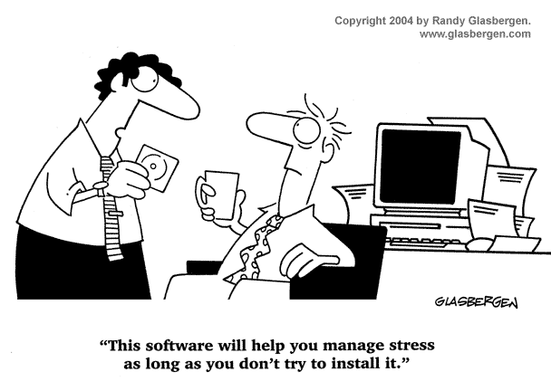
Statistical Computing Environment
Note: Software installation will be the hardest part of today -- and you may not finish during class (!)
If instructions here don’t work you, please raise your hand
Please share what did work for you here
Git | Virtual Environments
SourceTree | Jupyter Lab
Python 3.6+ | PyCharm
[5]

Slide 17
Why this Statistical Computing Environment?
Used in industry → marketable skill (!)
Helps with reproducibility of results locally + in production
Eases collaboration with Data Analysts, Data Scientists, Data Engineers, Software Engineers and Leadership

Slide 18
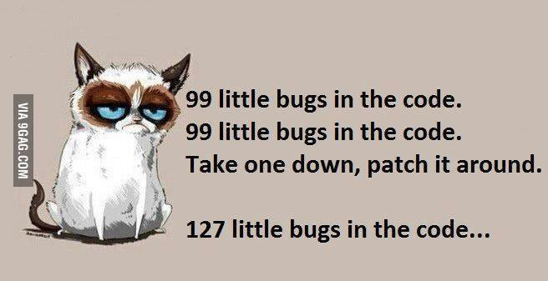
Why Git?
No more:
File_final.csv
File_final2.csv
File_final_final.csv
…
Easier to collaborate without emailing files
Easier to maintain multiple versions of file and switch between them
EX: resume tailored to different companies :)
EX: talks/tutorials given at different times
Easier to understand and undo changes if your code was ‘just’ working
(many more)
[1]

Slide 19
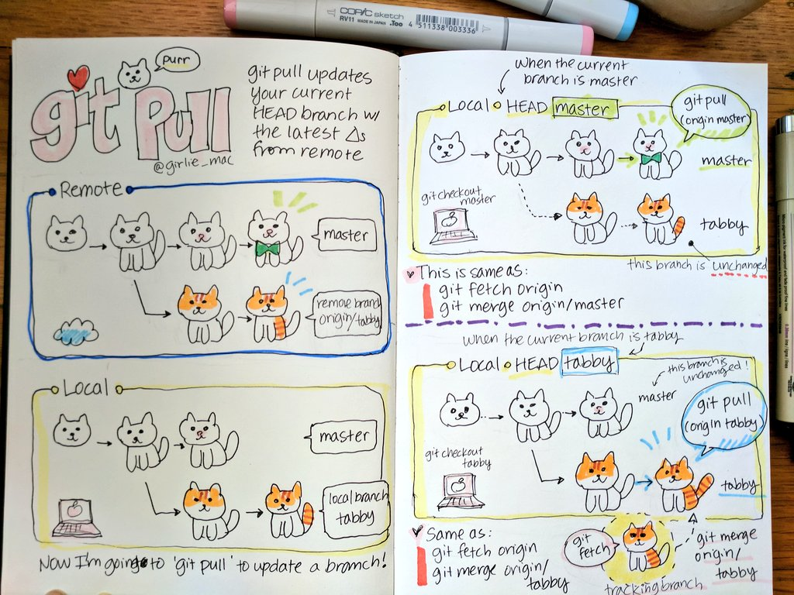
Why Git?
Advantage of Git:
Provides ability to track
changes in code and
collaborate with colleagues.
Git with cats →

Slide 20
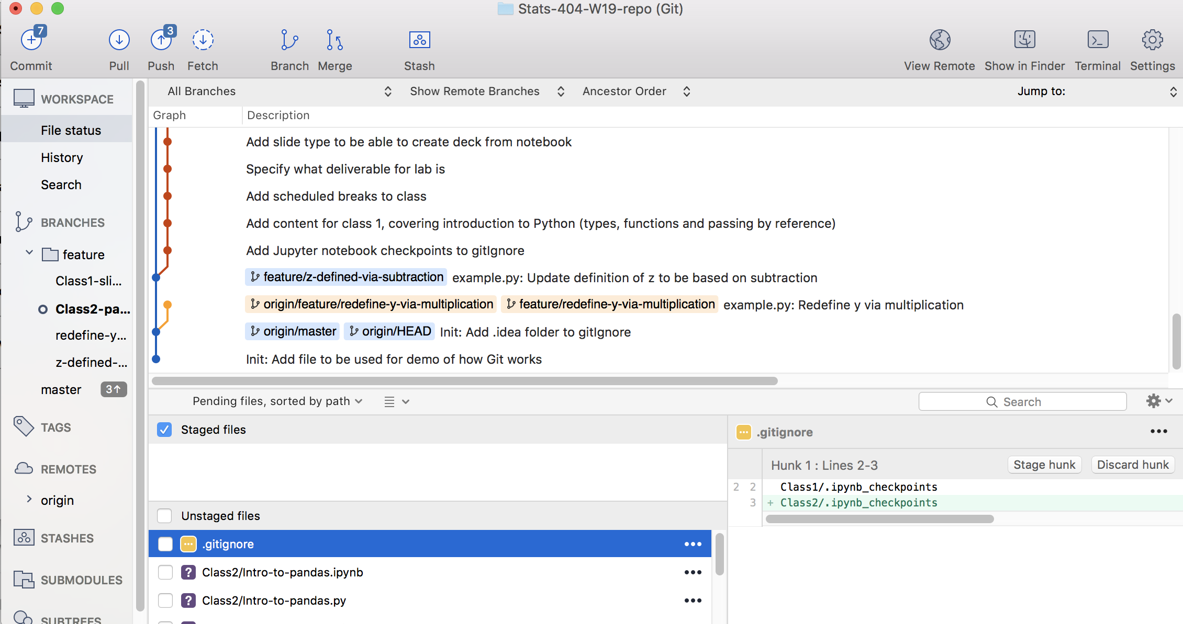
Git - SourceTree Terminology
Repositories
Origin = cloud
Master = local
Unstaging = WIP
Staged + Commit
File changes
Keeping
Branches
Color-coded diverging versions of code
Active branch in bold

Slide 21
Git - SourceTree
Installation instructions:
Create an account with GitHub (if you don’t have one)
Download and install Git
Create an account with Atlassian account to be able to register SourceTree
Note: select ‘Cloud’ during Atlassian registration
Download and install SourceTree (GUI for Git) and complete bullets 1-4 on the website, logging-in with existing account created in Step 3 above
Note: Bitbucket allows you to have free private (vs GitHub has free public) repositories
If instructions here don’t work you, please raise your hand
Please share what did work for you here

Slide 22
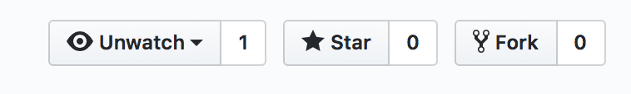
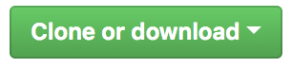
Git - SourceTree
Getting local copy of class content:
Navigate to https://github.com/ikukuyeva/Stats-404-W19-Statistical-Computing
Fork the repository, to create your copy of class repository with code changes unique to you, by clicking on the top-right icon:
Navigate to https://github.com/<your-user-name> and click on repository Stats-404-W19-Statistical-Computing
Click on button and copy URL you see (it ends in .git)
Open SourceTree
Clone repository for the course to your local machine:
File → New → Clone from URL → <paste URL from above step>
Note: If you don’t like where SourceTree wants to clone/save the repository on the local machine, click on … on the far right and select the location you want

Slide 23
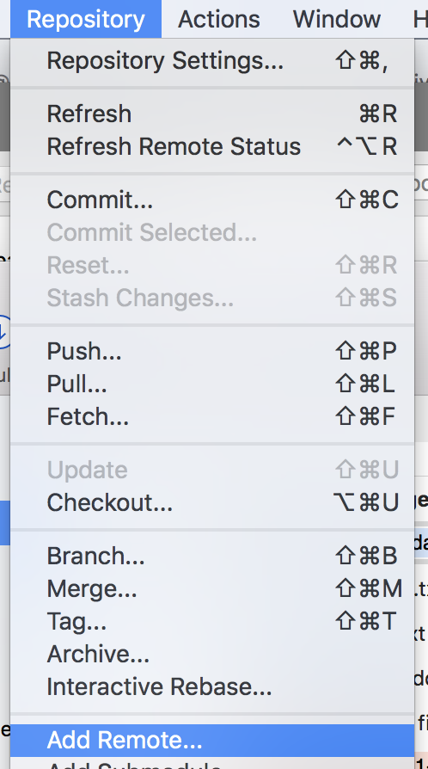
Git - SourceTree
Getting local copy of class content (cont’d):
Check that you Forked (created a copy under your username) and not Cloned (using the class repository), by going to:
SourceTree menu → Repository → Add Remote → canceling the prompt → and checking that the ‘origin’ path includes your username (and not ikukuyeva)

Slide 24
Git - SourceTree: First (Local) Commit
Step 1: Make changes to code base (e.g. ‘Class0-Intro/example.py’) locally:
Remember where you saved the class files on your machine
Navigate to that folder, ‘Class0-Intro’ subfolder and find “example.py” in the folder you just cloned from cloud
Open file example.py in TextEdit/Notepad, etc. (for now)
Change definition for x
Save the file

Slide 25
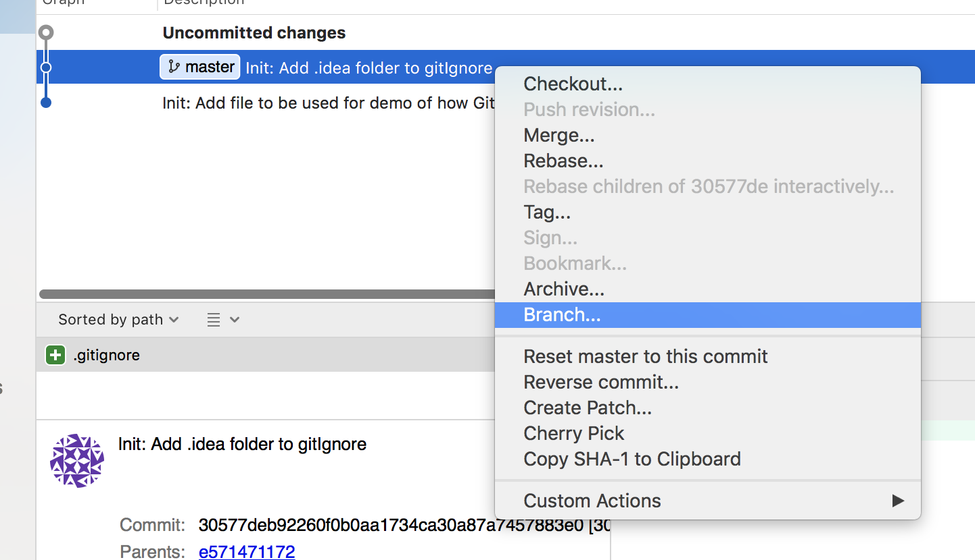
Git - SourceTree: First (Local) Commit
Step 2: Save those changes to code base (e.g. ‘Class0-Intro/example.py’), in SourceTree:
Create branch for changing definition of x, by:
Right-clicking on most recent and selecting ‘Branch’
Name your branch
e.g. feature/z-defined-via-subtraction
TIPS for branching:
You should create a branch when making any code
changes and add bugfix/feature qualifier to name
Location of branch reflects which changes you want to include as starting point
Branch should have single scope. Name it well, describing what you’re planning to do (e.g. scope)

Slide 26
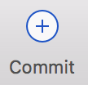
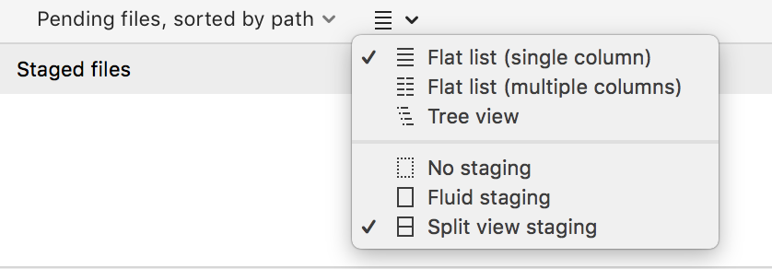

Git - SourceTree: First (Local) Commit
Step 2 (cont’d):
Scroll to most recent entry under ‘Description’ to see ‘Uncommitted Changes
Click on ‘Uncommitted Changes’, your should see an area for staged and unstaged files show on the bottom part of screen
Note: if you don’t please select the options as shown in dropdown (below)
Click on checkbox next to example.py (in ‘Unstaged Files) to move them to ‘Staged Files’, for tracking current version of this file
Click on ‘Commit’ icon at the top to save these changes
In the bottom panel, underneath your name and email, add a message explaining WHAT changed in the code and WHY you did it
Click ‘Commit’
Your changes are now saved locally

Slide 27
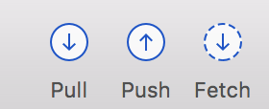
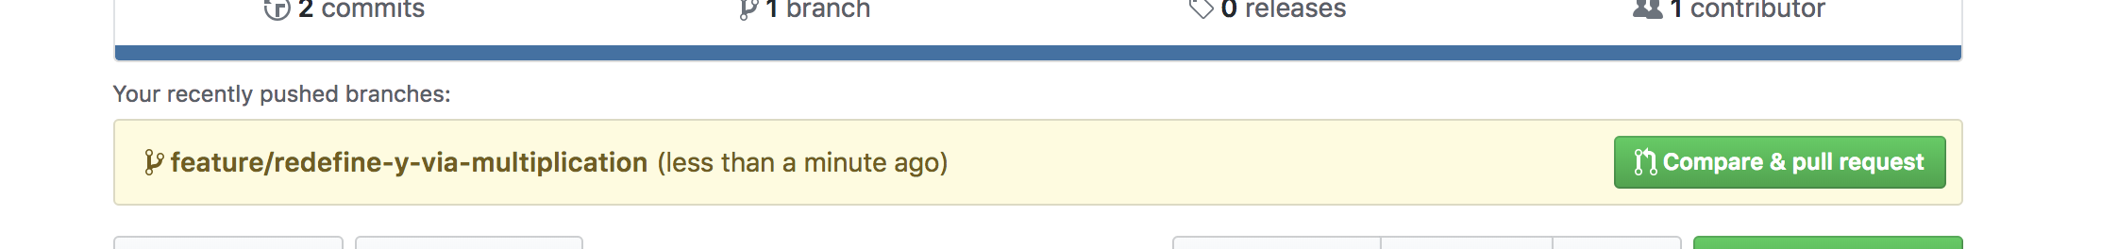
Git - SourceTree: First (Cloud) Commit
Step 3: Code in your local branch has committed local changes that are ready to be in cloud/shared
In SourceTree, “Push” the branch with changes to origin (i.e. cloud)
In SourceTree, Click on checkbox next to your new branch, to create one in cloud
Check that your changes are in cloud, by:
In Browser, navigate to your copy of the repository on GitHub: https://github.com/<your-user-name>/Stats-404-W19-Statistical-Computing
Do you see the latest changes, updated “less than a minute ago”?

Slide 28
Git - SourceTree: Merging into Master
Step 4: Update ‘master’ branch in cloud with latest code changes
In Browser,
Navigate to your copy of the repository on GitHub: https://github.com/<your-user-name>/Stats-404-W19-Statistical-Computing
Click on ‘Compare and pull request’ (see screenshot below)
Check that the branches you want to merge are correct -- and -- that both branches reflect your repository (i.e. start with your username)

Slide 29
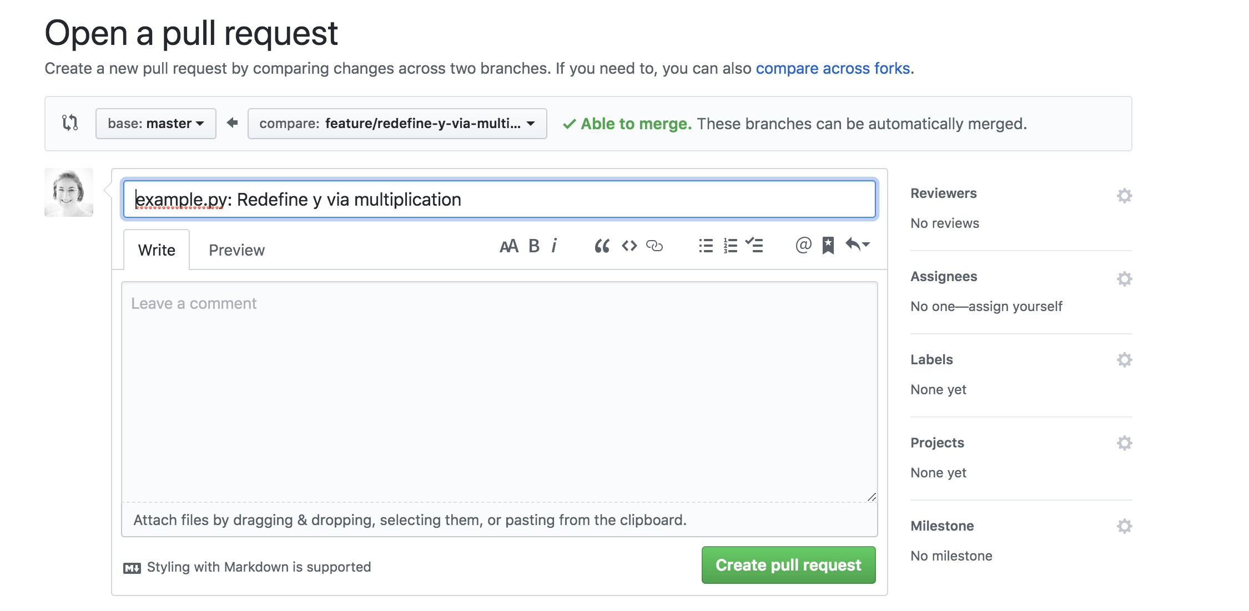
Git - SourceTree: Merging into Master
Step 4: (cont’d):
Add description explaining changes that you made in “Leave a comment” section
Note: This comment is for reviewer to get an idea of the code changes that you’d like them to review (before they see any code) -- and anything they should really focus on.
Click “Create pull request”
https://github.com/<your-user-name>/Stats-404-W19-Statistical-Computing/pulls should show new pull request
Note: You will also get an email from GitHub that a PR was created. Check that GitHub Settings → Notifications → Include your own updates

Slide 30
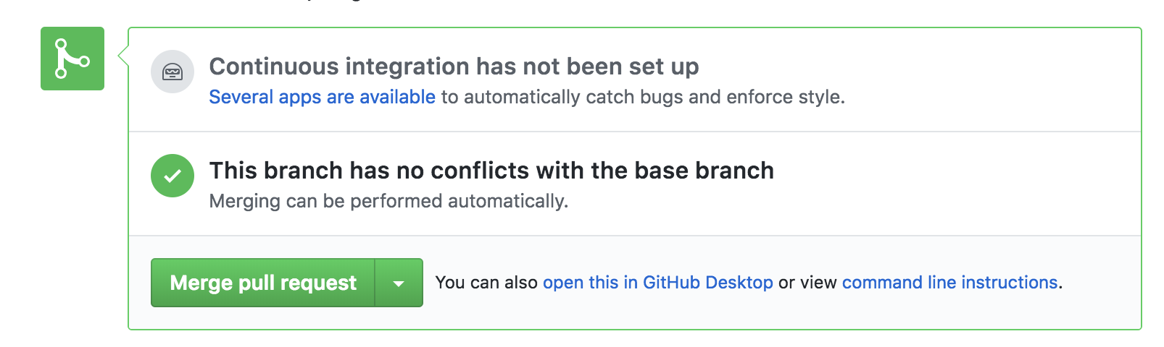
Git - SourceTree: Merging into Master
Step 4: (cont’d):
When collaborating with others,
assign code reviewers in pull request, on right-hand side
When review is done, you get to click
“Merge pull request”
Note: Continuous Integration will be (very) briefly covered in Week 8,

Slide 31
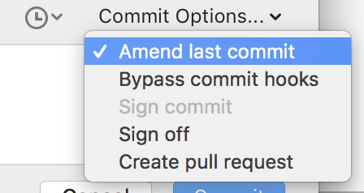
Git/SourceTree Tips
General tips for making and tracking changes to code base:
TIP: One idea per commit (!) → easier to undo + merge/find changes
Note: In EX 1, we committed the whole file at once -- because we only had one change.
If we had multiple items/ideas that we changed, you can click on lines in a file that had unstaged changes and ‘Stage lines’, select lines at time
TIP: To undo changes
In code: right-click on commit you want to undo and click on ‘Reverse changes...’
In (last) commit message: click on ‘Commit’ then on the right-hand side, select ‘Amend last commit’ from dropdown

Slide 32
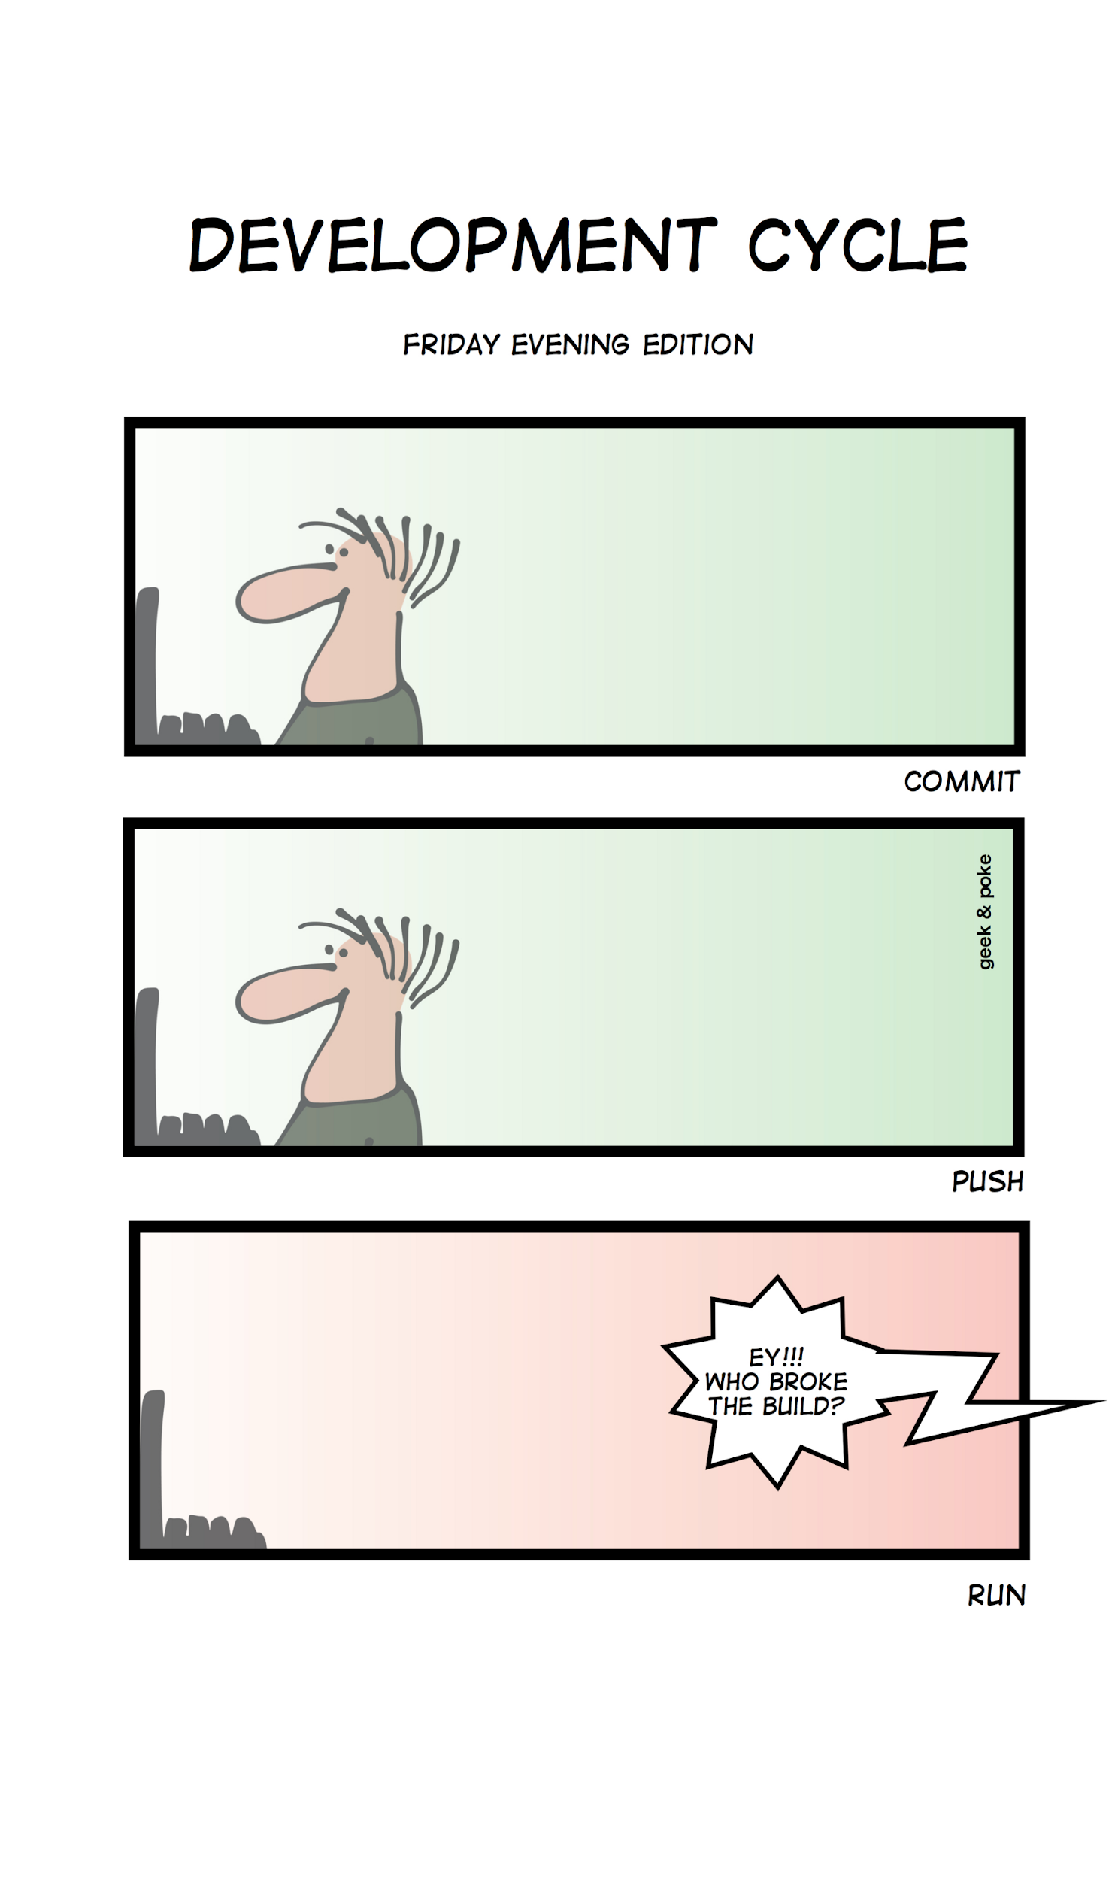
Additional Resources
Introduction to Git tutorial for command-line
Git handbook
Git cheat sheet
SourceTree tutorial (with Windows screenshots)
[2]

Slide 33
15 minute break

Slide 34
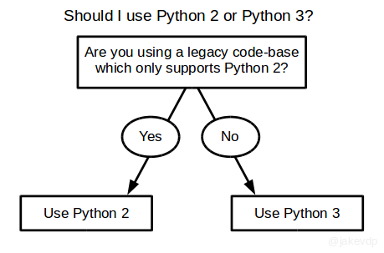
Why Python 3?
[3]

Slide 35
Python - Base (Mac Install)
Download Python 3.5+
Install Python 3.5+ following these instructions for Mac, skipping last section “Pipenv & Virtual Environments”
To find your ~/.profile go to:
cd $HOME
ls -la to see all of your files
vi .bash_profile
To make changes to the file:
Press i for insert
Copy and paste the line into the file or type it in
Save changes by pressing `Esc` and wq! to exit the file
To make sure the changes in your profile are registered on the machine, in Terminal, run source ~/.bash_profile
You’ve successfully installed Python, if typing python (or python3) in Terminal, starts Python for you.
Note: If instructions here don’t work you, please raise your hand + share what did here

Slide 36
Python - Base (Windows Install)
Download Python 3.5+
Please start on p. 40 of this book for Python installation instructions on Windows 10 and complete Steps 1-4
Note: If instructions here don’t work you, please raise your hand + share what did here

Slide 37
Python - Base (Linux Install)
Download Python 3.5+
Please start on p. 20 of this book for Python installation instructions on Ubuntu 16.04 and complete Step 1 only
Note: If instructions here don’t work you, please raise your hand + share what did here

Slide 38
15 minute break

Slide 39
Python - Reproducibility of Results
Step 1: Create Virtual Environment -- Why do we need virtual environments?
Decide how you want to manage the virtual environment files:
Option 1: Each project will have its own virtual environment files in its own “Envs” sub-folder associated with it
e.g. project1/Envs and project2/Envs
Option 2: You have one “Envs” folder on your machine with all virtual environment files for all your projects
e.g. Documents/Envs
Which option did you decide on?

Slide 40
Python - Reproducibility of Results
Step 1: Create Virtual Environment (cont’d)
In Terminal:
Navigate to directory where want to save files related to virtual environment
Determine if you’re using pip or pip3 to install packages
Note: Python packages are installed from command line via pip, similar to install.packages() in R.
Note: if on slide 34, you started python with python3 command, you should use pip3 to install packages. (More on pip here)
Install Python package virtualenvwrapper: pip install virtualenvwrapper

Slide 41
Python - Reproducibility of Results
Step 1: Create Virtual Environment (cont’d)
Decide on name of virtual env
e.g. env-stats404-class0 (assuming we have one environment per class)
e.g. env-thesis (assuming different set of packages for thesis)
Create a virtual environment:
export VIRTUALENVWRAPPER_PYTHON=$(which python3.7)
source /usr/local/bin/virtualenvwrapper.sh
export WORKON_HOME=./Envs
mkvirtualenv env-stats404-class0
Note: If these commands don't work for you, see next slide.

Slide 42
Python - Reproducibility of Results
Step 1: Create Virtual Environment (cont’d)
If the previous 4 lines did not work for you, you may need to do any/all of the following:
Line 1: $(which python3.7) points to the complete path to where python is installed on your machine; you may need to search for and find it on your machine first and then paste the path to python3.7 (for example) or python.exe (if on Windows), instead of $(which python3.7)
Line 1: If you're on Windows, the equivalent keyword to export is SET
Line 2: Similarly, to specifying the python path, the next line specifies the path to the file virtualenvwrapper.sh that you installed with pip. You may need to search for find it on your machine first and then paste the path into the line.
Line 3: Will create an "Envs" folder in your current working directory, after lines 3 and 4 are run

Slide 43
Python - Reproducibility of Results
Step 1: Create Virtual Environment (cont’d)
To use the virtual environment you just created, in Terminal:
Start virtual env: source Envs/env-stats404-class0/bin/activate
Stop virtual env: deactivate
Note: If you set up the “Envs” folder per Option 1 (on slide 39), make sure to ignore these files in the repository (if you went with Option 2, ignore below) -- to make your repository easier to digest:
Open SourceTree, navigate to class repository
Navigate to ‘Uncommitted Changes’
Right-click on one of the newly created virtual environment files
Select ‘Ignore’ and radio button ‘Ignore everything beneath’: ‘Envs’ folder
Commit this gitignore file to the repository

Slide 44
Python - Reproducibility of Results
Step 2: Manage package versions through requirements.txt + Git -- why do we need package managers?
In Terminal:
Activate your virtual environment
Change directories until you’re in your local copy of (forked) class folder
Check that only base Python is installed:
Run pip freeze > requirements.txt to create a snapshot of Python packages currently installed in your virtual environment in file requirements.txt
Open created requirements.txt file (in TextEdit/Notepad/etc.) to see what’s there -- it should be empty
TIP: If file is not empty: install different (clean) Python 3.5+ version OR port existing projects on your machine to their own virtual environments, and only then, uninstall all of the packages from base:
pip uninstall -r requirements.txt

Slide 45
10 minute break

Slide 46
Python - IDEs
IDEs used in this course:
Jupyter Lab (see next section for installation instructions) -- for interactive data analysis
PyCharm -- for software development (installed later today)
Note: If instructions here don’t work you, please share those that did here

Slide 47
Why Jupyter Lab?
Pros:
Exploratory and interactive data analysis
Reproducible documents and slide decks (!)
Version-control notebook by tracking changes by exporting is as a Python script. In Terminal, in virtual environment for notebook (see slide 47 for how to activate virtual environment with notebook):
ipython nbconvert --to=python <name-of-notebook>.ipynb
Present results to team members and other teams by converting it into a slide deck. In Terminal, in virtual environment for notebook:
jupyter nbconvert <name-of-notebook>.ipynb --to slides --post serve
Share results with team members and other teams by exporting it to HTML format (and many other formats), by going to File -> Export Notebook As...
Notes:
Aside: $ jupyter nbconvert <notebook_name>.ipynb --to slides --post serve
Per https://github.com/jupyterlab/jupyterlab/issues/5018 to create slide deck from notebook
Aside $ ipython nbconvert --to=python Intro-to-Python.ipynb
to convert notebook to Python code

Slide 48
Why Jupyter Lab?
Cons:
Results are reproducible, if (at minimum) you’re able to ‘Run All’ cells and no errors are thrown
TIP: ‘Run All’ cells from beginning ahead of committing/sharing version of notebook
Other caveats
Notes:
Aside: $ jupyter nbconvert <notebook_name>.ipynb --to slides --post serve
Per https://github.com/jupyterlab/jupyterlab/issues/5018 to create slide deck from notebook
Aside $ ipython nbconvert --to=python Intro-to-Python.ipynb
to convert notebook to Python code

Slide 49
Jupyter Lab Installation
Activate the virtual environment
Install JupyterLab for working with interactive Python notebooks by:
Add this line to requirements.txt file (created on slide 44): jupyterlab==0.35.4
Install packages from command line pip install -r requirements.txt
Commit requirements.txt to your forked repo (following steps outlined on Slides 22-27) and push changes to cloud’s ‘master’ branch
Sample commit message: Adding requirements.txt file that tracks packages required to run/recreate content for class

Slide 50

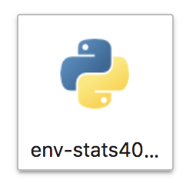
Jupyter Lab - Reproducibility of Results
Run Jupyter Lab in Virtual Environment
Activate your virtual environment, e.g. env-stats404-class0
Tell Jupyter lab that we’re using it:
python -m ipykernel install --user --name env-stats404-class0
Start Jupyter lab from command line: jupyter lab
Navigate to “Notebook” header
Click on kernel with name of virtual environment from bullet 1
This activates an “Untitled.ipynb”
Check that virtual environment is connected to notebook:
Notes:
Aside: $ jupyter nbconvert <notebook_name>.ipynb --to slides --post serve
Per https://github.com/jupyterlab/jupyterlab/issues/5018 to create slide deck from notebook
Aside $ ipython nbconvert --to=python Intro-to-Python.ipynb
to convert notebook to Python code

Slide 51

Jupyter Lab - Reproducibility of Results
Run Jupyter Lab in Virtual Environment (cont’d): When you’re done with notebook:
→ “Save Notebook”
→ “Close and Shutdown Notebook” and Confirm shutdown
→ “Quit” to quit Jupyter Lab and stop the kernel
Notes:
Aside: $ jupyter nbconvert <notebook_name>.ipynb --to slides --post serve
Per https://github.com/jupyterlab/jupyterlab/issues/5018 to create slide deck from notebook
Aside $ ipython nbconvert --to=python Intro-to-Python.ipynb
to convert notebook to Python code

Slide 52

5 minute break
[7]

Slide 53
Why PyCharm?
If you’re not using an IDE (Integrated Development Environment) already, I recommend PyCharm (there are other Python IDEs) for its:
Ability to specify different virtual environments for different projects and seamlessly switch between them
Syntax highlighting that:
Points out when variable/module is not used anywhere in code
Identifies when you’re not following PEP8
Works with specifying variable type hints (more on that in Week 8)
Debugging capabilities
Cons: there is a learning curve to getting virtual environments and folder paths working with PyCharm. We’ll work on this together now.

Slide 54
PyCharm Installation & Set-Up
Download PyCharm Community Edition and install
Start PyCharm by double-clicking)
Note: Select “Don’t import previous settings”
Note: Don’t need to run “launcher script”
Click on “Open”
Select folder with repository for class (downloaded from GitHub)
Note: This will create a PyCharm project for you.
Note: If instructions here don’t work you, please share those that did here

Slide 55
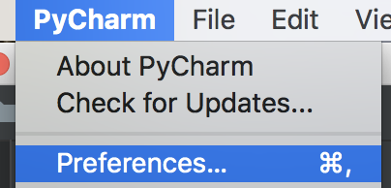
PyCharm Installation & Set-Up (cont’d)
Run PyCharm project with Virtual Environment
PyCharm → Preferences
Project <name> → Project Interpreter
Click on settings icon on far right → Click on “Add” → Select radio button for “Existing environment” → Click on “...” on the far right and find your virtual environment in Envs folder → click on <env name> → click on bin → python 3.7 → OK → OK → Apply → OK
Example of virtual Python 3.7 location in my virtual environment: /Users/irina/Documents/Stats_404_W19/Envs/env-stats404-class0/bin/python3.7
Tools → Terminal → Specify path to your project (e.g. Stats 404 repository folder) on your computer
Example of folder path: /Users/irina/Documents/Stats_404_W19/Stats-404-W19-repo

Slide 56
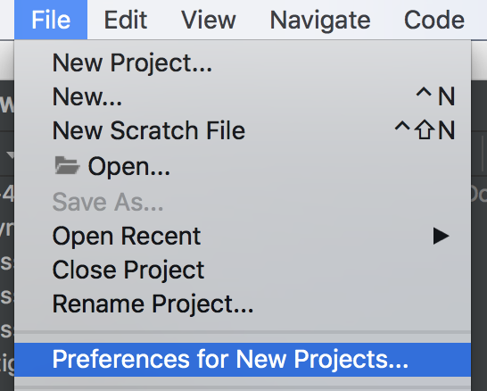
PyCharm Installation & Set-Up (cont’d)
File → Preferences for New Projects
Project Interpreter
Select your virtual env from drop down in “Project Interpreter” → Apply → OK
Build, Execution and Deployment → Console → Python Console
Select your virtual env from drop down in “Project Interpreter” → Apply → OK
Reopen project in PyCharm
(Optional) Color customization for Git/Console in PyCharm
(Optional) Further reading -- Quick Start Guide

Slide 57

15 minute break
You Did It!
Software is installed!
[6]

Slide 58
Python - Running First Script
Open PyCharm and select the project we created today
In Terminal window of PyCharm:
Change directories into “Class0-Intro” folder
cd Class0-Intro/
Run script:
python example.py
(Mentally) Check that the printed number is the one you’d expect

Slide 59
HW 1

Slide 60
HW 1 -- Assignment
Due: Wednesday, January 16: HW 1 due by EOD via email to TA (cc instructor)
Finish setting-up software environment on your machine (if you didn’t finish in class)
Email us the requirements.txt file of your environment
Share your GitHub username
Find/pick data set you want to analyze for final project (slide 12):
Be strategic
Determine what (business) question you’d like to answer
Thesis OK
Send us: link to data set and 2-3 sentences explaining why you picked the data set you did

Slide 61
Questions?

Slide 62
Additional Resources
Tutorials/cheat sheets for navigating the command line:
https://www.git-tower.com/blog/command-line-cheat-sheet/ and
http://simplyadvanced.net/blog/cheat-sheet-for-windows-command-prompt/ for Windows

Slide 63
Appendix
[1] https://www.devrant.io/search?term=debugging
[2] http://geek-and-poke.com/geekandpoke/2014/2/23/dev-cycle-friday-evening-edition
[3] https://twitter.com/jakevdp/status/545584663566508033
[4] https://blog.revolutionanalytics.com/2018/06/pypl-programming-language-trends.html
[5] https://www.glasbergen.com/ngg_tag/manage-stress/
[6] https://pixabay.com/en/fireworks-new-year-s-eve-sparkler-1993221/
[7] http://www.keepcalmandposters.com/poster/2443716_keep_calm_were_almost_done

